Slide 1

KLH UNIVERSITY
SEC 8 | TEAM 22
PROJECT ABSTRACT SUBMISSION • TRIMESTER 4 (2026-2027)
Hostel & Mess Management System
A Relational Database-Driven Solution for Administrative Efficiency, Automated Allocation, & Dining Intelligence
PROJECT TEAM MEMBERS
Dhanush - 2520030014
Varshith Reddy - 2520030250
Pranav Chowdary - 2520030555
COURSE CODE & TITLE
25CS1302E • Database Systems Engineering & Distributed Backend Dev

Slide 2


EXECUTIVE SUMMARY
Modernizing Campus Operations & Data Workflows
Slide 02
Legacy Paper-Based Challenges
Database-Driven Solution
Manual Paperwork: Slow physical registers lead to registration bottlenecks.
Centralized Database: Unified relational schema in MySQL engine.
Data Duplication: Disconnected files cause conflicting student records.
Automated Operations: Real-time room allocation & mess attendance.
High Data Integrity: Foreign keys enforce zero duplicate records.
High Inefficiency: Hours spent verifying room status and fee receipts.
Instant Retrieval: Sub-second query lookups for wardens & students.
Audit Vulnerability: Lack of centralized query tracking and data history.
Strategic Goal: Bridge operational gaps through transparent, automated, and secure digital management.

Slide 3




SYSTEM MODULE 01
Hostel Accommodation & Residence Control
Slide 03
Student Profiles
Room Allocation
Fee Management
Logs & Complaints
Centralized student registry with contact, guardian data, and academic credentials.
Real-time tracking of room occupancy, block capacity, and automated assignments.
Automated payment tracking, due notices, and digital receipt generation.
Digital gate passes, nightly attendance logs, and warden ticketing workflows.
Warden Dashboard Capability: Instant filtering for vacant beds, maintenance tickets, and overdue residential payments.

Slide 4
SYSTEM MODULE 02
Mess Operations & Food Administration
Slide 04
Meal Registration
Dining Attendance
Menu Management
Mess Ledger
Dynamic student opt-in/opt-out selections for daily meal planning.
Automated dining hall check-in logging to prevent unrecorded entries.
Weekly meal schedule updates, nutrition info, and special diet tags.
Itemized monthly rebate calculations and automated bill generation.
Operational Benefit: Minimizes food waste by forecasting meal demand and ensures exact billing based on actual dining attendance.

Slide 5
TECHNICAL ARCHITECTURE
Frameworks & Multi-Tier Stack
Slide 05
FRONTEND LAYER
BACKEND LAYER
DATABASE LAYER
User Interface
Application Server
Relational Engine
HTML5, CSS3, JavaScript
Java / Spring Boot Framework
MySQL & MySQL Workbench
Interactive user dashboards for students and administrative wardens with real-time form validation.
Distributed business logic, REST controllers, session management, and secure query processing.
Normalized tables, primary/foreign key constraints, transactional stability, and indexed queries.
Development IDE: IntelliJ IDEA / Eclipse
Deployment OS: Windows OS Environment
Course Code: 25CS1302E DBSE

Slide 6



VALUE PROPOSITION
Key System Advantages & Institutional Impact
Slide 06
Reduced Overhead & High Accuracy
Automates daily registration entries to eliminate human error and physical register maintenance.
Fast Query Execution & Reporting
Indexed MySQL database tables enable instant lookup of student records, bed counts, and payment status.
Data Integrity & Zero Redundancy
Relational keys prevent duplicate student accounts, double-booking rooms, or billing mismatches.
Delivering structured, scalable, and transparent administration across educational campus environments.

Slide 7
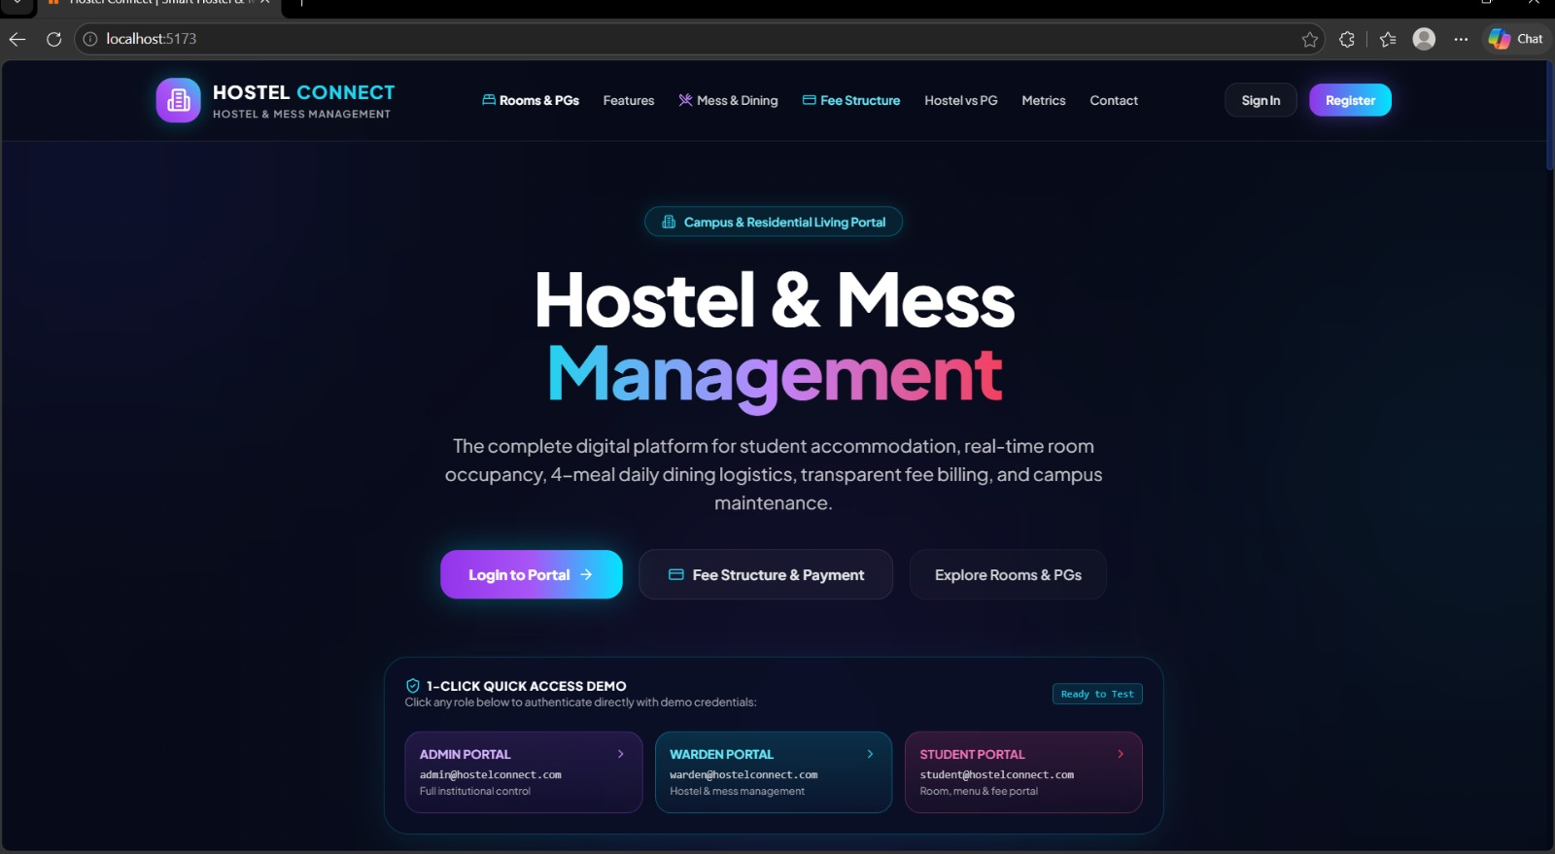
FrontEnd

Slide 8
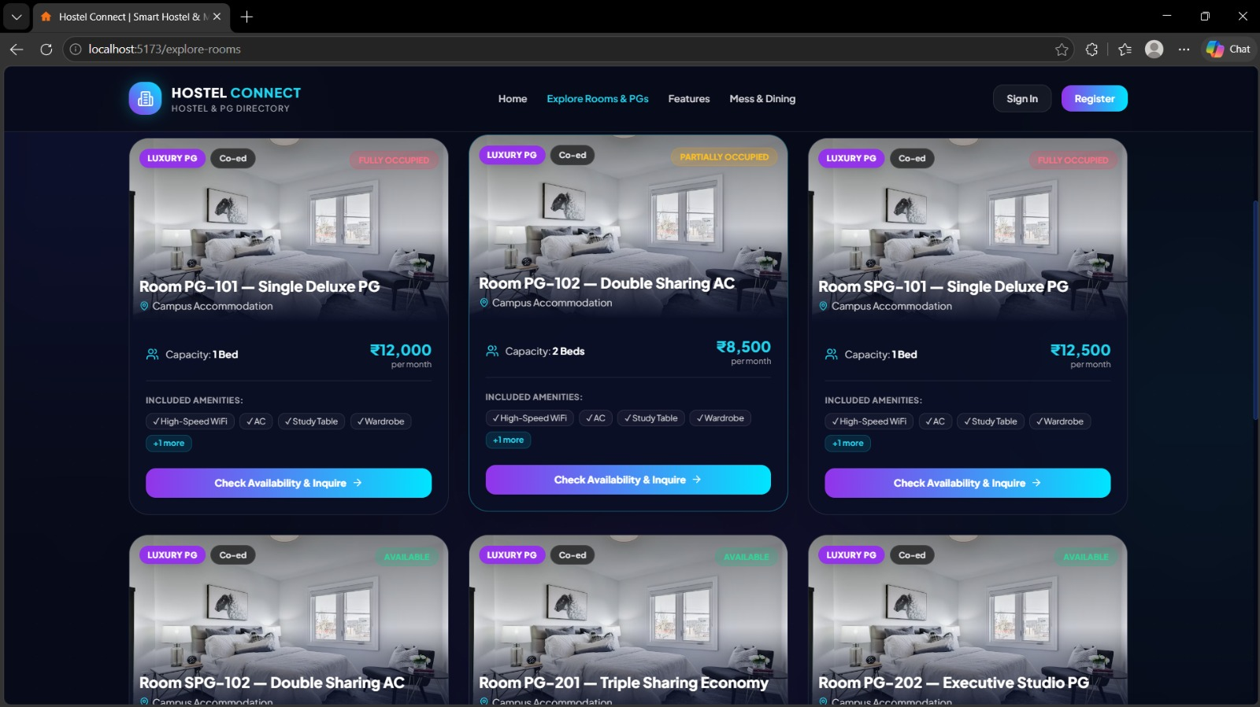
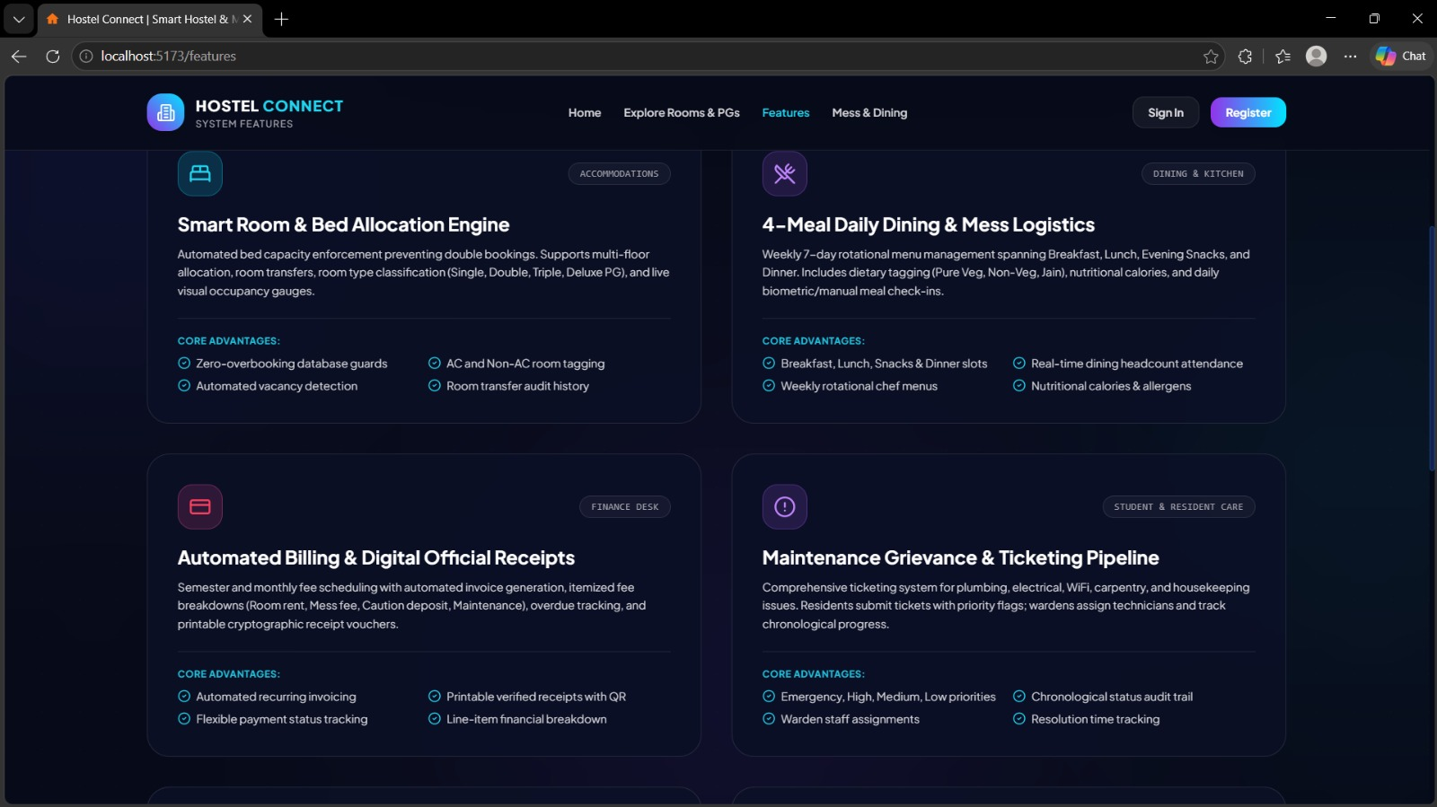

Slide 9
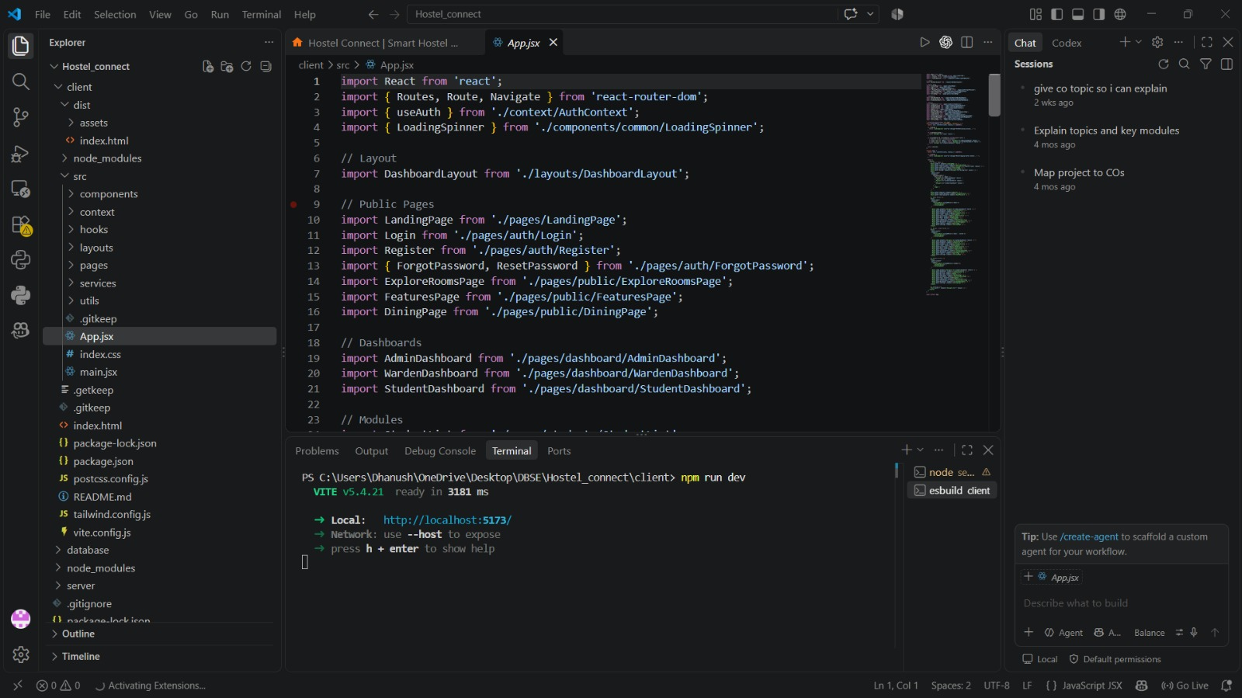
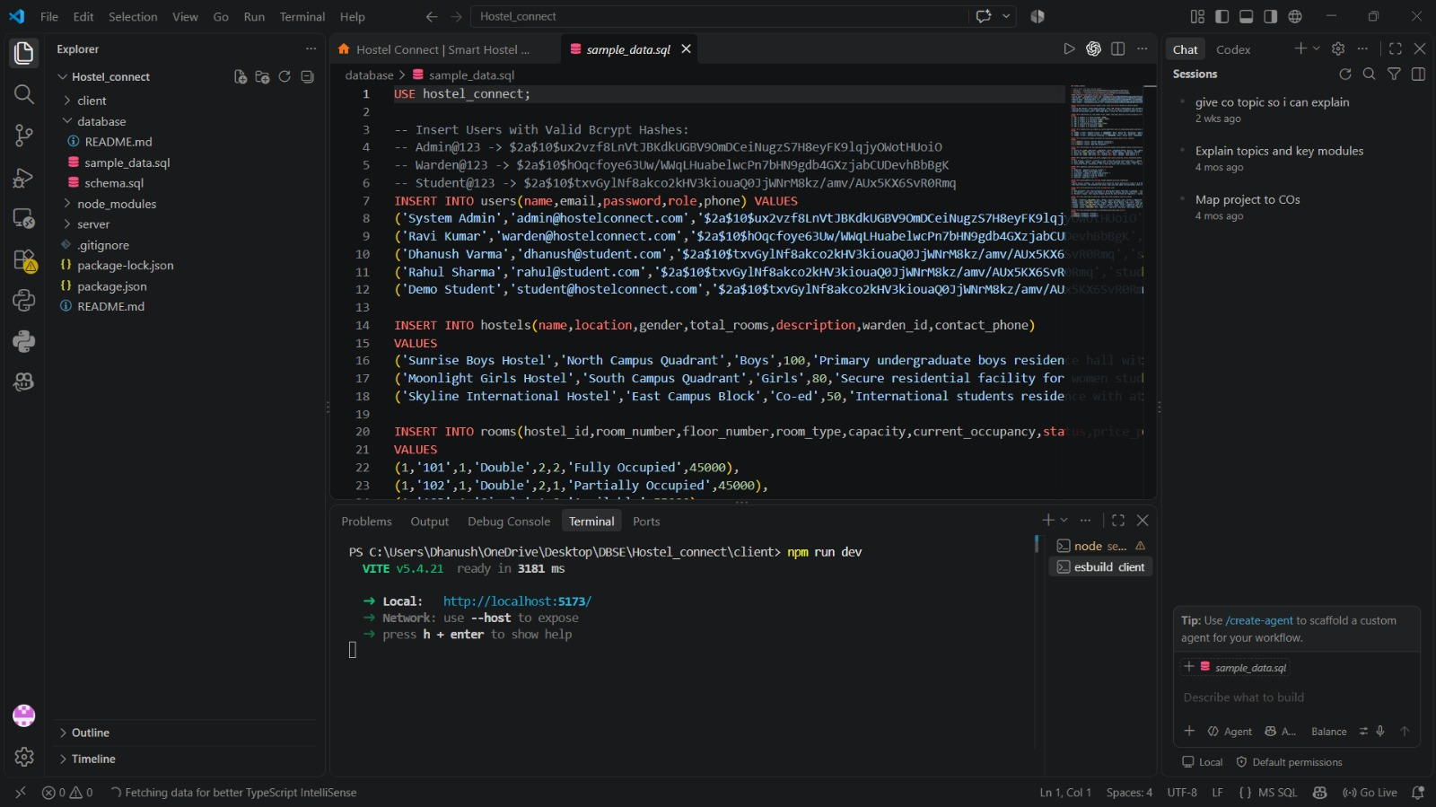
Back-End

Slide 10
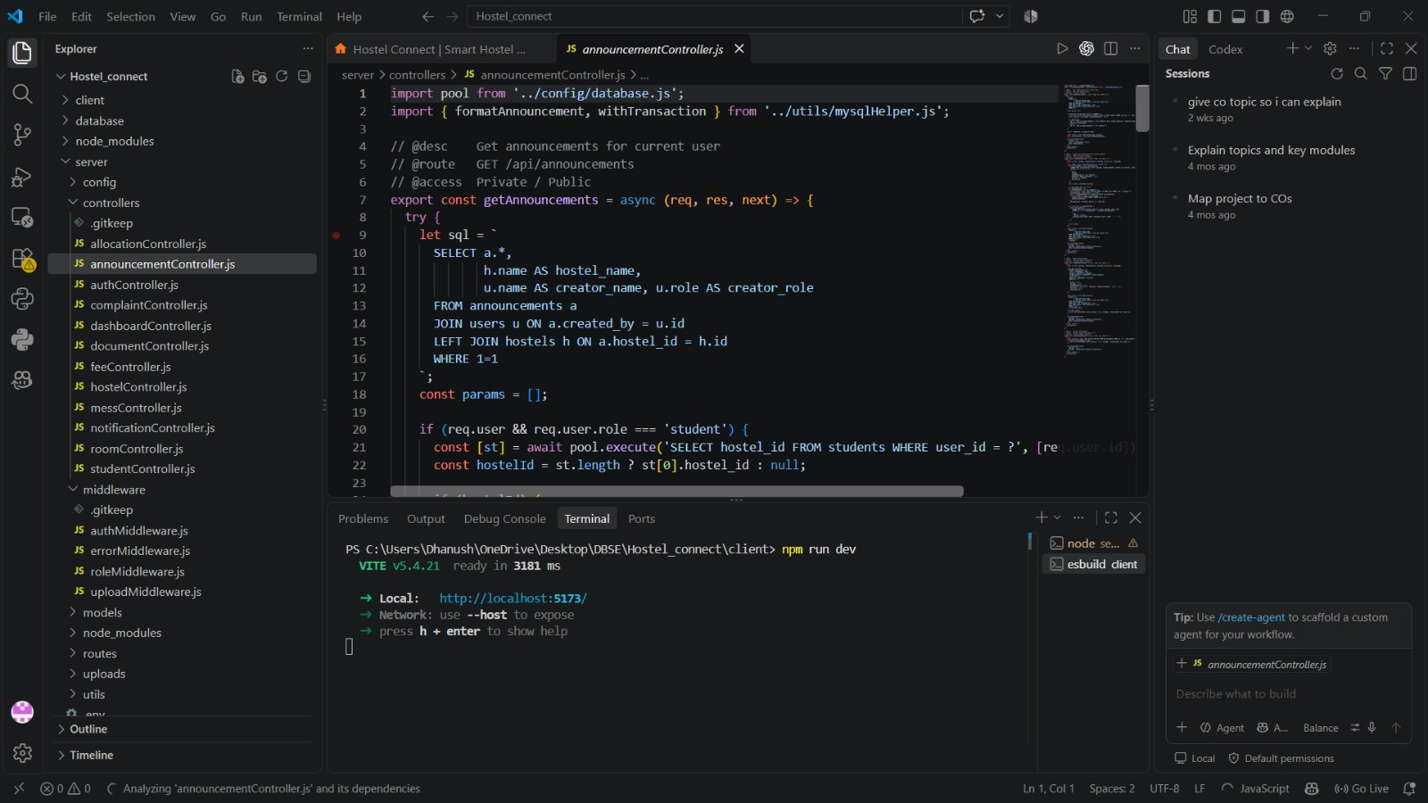

Slide 11

Thank You!
Hostel & Mess Management System • Abstract Presentation
Questions & Discussion

